Slide 1
SOFTWARE ENGINEERING

Slide 2
SOFTWARE ENGINEERING
It is the systematic, disciplined, cost effective technique for software development.
Software is a program or set of programs containing instructions that provide desired functionality.
Software, when made for a specific requirement is called software product.
And Engineering is the process of designing and building something that serves a particular purpose and finds a cost-effective solution to problems.
Software engineering is an engineering branch associated with development of software product using well-defined scientific principles, methods and procedures. The outcome of software engineering is an efficient and reliable software product.

Slide 3
NEED OF SOFTWARE ENGINEERING
The need of software engineering arises because of higher rate of change in user
requirements and environment on which the software is working.
To manage Large software - It is easier to build a wall than to a house or building, likewise, as the size of software become large engineering has to step to give it a scientific process.
For more Scalability- If the software process were not based on scientific and engineering concepts, it would be easier to re-create new software than to scale an existing one.
Cost Management- As hardware industry has shown its skills and huge manufacturing has lower down he price of computer and electronic hardware. But the cost of software remains high if proper process is not adapted.
To manage the Dynamic Nature- The always growing and adapting nature of software hugely depends upon the environment in which user works. If the nature of software is always changing, new enhancements need to be done in the existing one. This is where software engineering plays a good role.
For better Quality Management- Better process of software development provides better and quality software product.

Slide 4
Product: In the context of software engineering, Product includes any software manufactured based on the customer’s request. This can be a problem solving software or computer based system. It can also be said that this is the result of a project.
Process: Process is a set of sequence steps that have to be followed to create a project. The main purpose of a process is to improve the quality of the project. The process serves as a template that can be used through the creation of its examples and is used to direct the project.

Slide 5
Difference between Product & process
The main difference between a process and a product is that the process is a set of steps that guide the project to achieve a convenient product.
while on the other hand, the product is the result of a project that is manufactured by a wide variety of people.

Slide 6
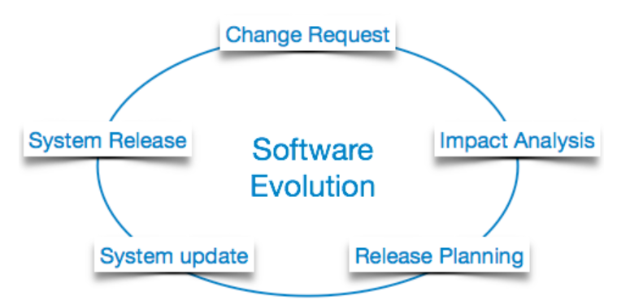
Software Evolution
The process of developing a software product using software engineering principles and methods is referred to as software evolution.
This includes the initial development of software and its maintenance and updates, till desired software product is developed, which satisfies the expected requirements.

Slide 7
Evolution starts from the requirement gathering process. After which developers create a prototype of the intended software and show it to the users to get their feedback at the early stage of software product development.
The users suggest changes, on which several consecutive updates and maintenance keep on changing too. This process changes to the original software, till the desired software is accomplished.
Even after the user has desired software in hand, updation of the existing software keep going

Slide 8
SDLC
Software Development Life Cycle, SDLC for short, is a well-defined, structured sequence of stages in software engineering to develop the intended software product.
It is a pictorial and diagrammatic representation of the software life cycle.
A life cycle model represents all the methods required to make a software product through its life cycle stages.
It also captures the structure in which these methods are to be undertaken.

Slide 9
Need of SDLC
Without using an exact life cycle model, the development of a software product would not be in a systematic and disciplined manner.
When a team is developing a software product, there must be a clear understanding among team representative about when and what to do. Otherwise, it would point to chaos and project failure.

Slide 10
Example- Suppose a software development issue is divided into various parts and the parts are assigned to the team members. From then on, suppose the team representative is allowed the freedom to develop the roles assigned to them in whatever way they like. It is possible that one representative might start writing the code for his part, another might choose to prepare the test documents first, and some other engineer might begin with the design phase of the roles assigned to him. This would be one of the perfect methods for project failure.

Slide 11
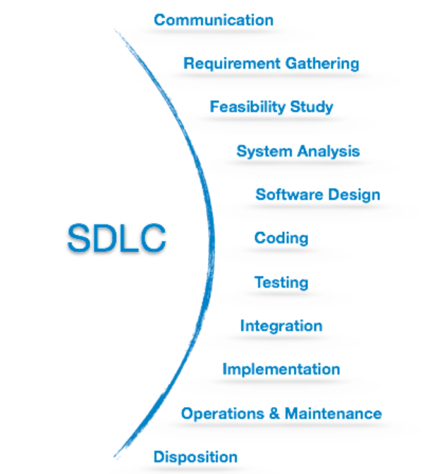
SDLC Cycle
SDLC Cycle represents the process of developing software. SDLC framework includes the following steps:

Slide 12
Communication
This is the first step where the user initiates the request for a desired software product. He contacts the service provider and tries to negotiate the terms. He submits his request to the service providing organization in writing.
Requirement Gathering
This step onwards the software development team works to carry on the project. The team holds discussions with various stakeholders from problem domain and tries to bring out as much information as possible on their requirements.
Feasibility Study
After requirement gathering, the team comes up with a rough plan of software process. At this step the team analyzes if a software can be made to fulfill all requirements of the user and if there is any possibility of software being no more useful. It is found out, if the project is financially, practically and technologically feasible for the organization to take up.

Slide 13
System Analysis
System analysis includes Understanding of software product limitations, learning system related problems or changes to be done in existing systems beforehand, identifying and addressing the impact of project on organization and personnel etc.
Software Design
The inputs from users and information gathered in requirement gathering phase are the inputs of this step. The output of this step comes in the form of two designs; logical design and physical design. Engineers produce meta-data and data dictionaries, logical diagrams, data-flow diagrams and in some cases pseudo codes.
Coding
This step is also known as programming phase. The implementation of software design starts in terms of writing program code in the suitable programming language and developing error-free executable programs efficiently.

Slide 14
Coding
This step is also known as programming phase. The implementation of software design starts in terms of writing program code in the suitable programming language and developing error-free executable programs efficiently.
Testing
An estimate says that 50% of whole software development process should be tested. Errors may ruin the software from critical level to its own removal. Software testing is done while coding by the developers and thorough testing is conducted by testing experts at various levels of code such as module testing, program testing, product testing, in-house testing and testing the product at user’s end. Early discovery of errors and their remedy is the key to reliable software.
Integration
Software may need to be integrated with the libraries, databases and other program(s). This stage of SDLC is involved in the integration of software with outer world entities.

Slide 15
Implementation
This means installing the software on user machines. At times, software needs post-installation configurations at user end. Software is tested for portability and adaptability and integration related issues are solved during implementation.
Operation and Maintenance
This phase confirms the software operation in terms of more efficiency and less errors. If required, the users are trained on, or aided with the documentation on how to operate the software and how to keep the software operational. The software is maintained timely by updating the code according to the changes taking place in user end environment or technology. This phase may face challenges from hidden bugs and real-world unidentified problems

Slide 16
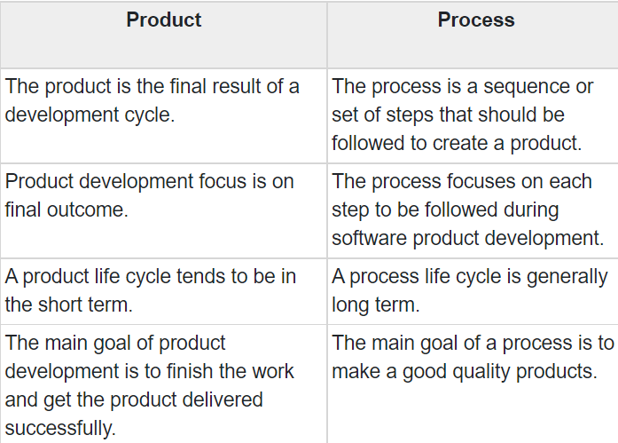
Difference between Process and product?

Slide 17
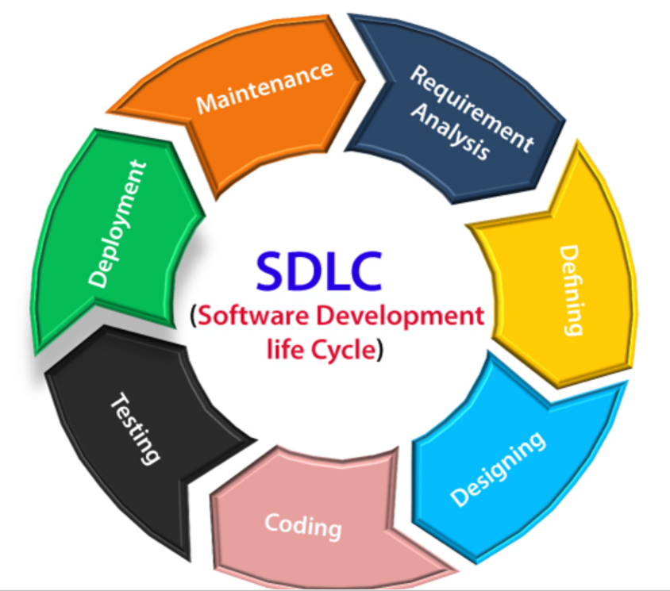
SOFTWARE DEVELOPMENT LIFE CYCLE
Software Development Life Cycle (SDLC) is a process used by the software industry to design, develop and test high quality software. The SDLC aims to produce a high-quality software that meets or exceeds customer expectations, reaches completion within times and cost estimates. (Systematic approach --- Customer- service provider)

Slide 18
THE STAGES OF SDLC
Stage1: Planning and requirement analysis
Business analyst and Project organizer set up a meeting with the client to gather all the data like what the customer wants to build, who will be the end user, what is the objective of the product. Before creating a product, a core understanding or knowledge of the product is very necessary.
(Startup company- in planning phase- what needed- cost-time how much I am having- -requirement-informal communication, formal communication, -all verbal communication done here )

Slide 19
THE STAGES OF SDLC
Stage2: Defining Requirements Once the requirement analysis is done, the next stage is to certainly represent and document the software requirements and get them accepted from the customer.
This is accomplished through "SRS"- Software Requirement Specification document which contains all the product requirements to be constructed and developed during the project life cycle.
(Idea of requirement of customer they got from planning phase- requirement of customer, estimations of cost, staff, charges of service provide, charge customer can give then negotiation. Then prepare a SRS (software requirement specification)-proper documentation in written. Customer can change later but 70% around requirement done by customer.)

Slide 20
Stage3: Designing the Software
The Design phase models the way a software application will work. Some aspects of the design include:
Architecture – Specifies programming language, industry practices, overall design, and use of any templates or boilerplate User Interface – Defines the ways customers interact with the software, and how the software responds to input Platforms – Defines the platforms on which the software will run, such as Apple, Android, Windows version, Linux, or even gaming consoles Programming – Not just the programming language, but including methods of solving problems and performing tasks in the application
Prototyping can be a part of the Design phase. A prototype is like one of the early versions of software in the Iterative software development model. It demonstrates a basic idea of how the application looks and works.
(No major role of customer-DFD-Front end back end-It helps in coding- layout of -House architecture - ERmodel in dbms-Technology-language)

Slide 21
Stage4: Developing the project
In this phase of SDLC, the actual development begins, and the programming is built. The implementation of design begins concerning writing code. Developers have to follow the coding guidelines described by their management and programming tools like compilers, interpreters, debuggers, etc. are used to develop and implement the code.
Stage5: Testing
After the code is generated, it is tested against the requirements to make sure that the products are solving the needs addressed and gathered during the requirements stage.
During this stage, unit testing, integration testing, system testing, acceptance testing are done.

Slide 22
Stage6: Deployment
In the deployment phase, the application is made available to users.
Stage7: Maintenance
Once when the client starts using the developed systems, then the real issues come up and requirements to be solved from time to time.
This procedure where the care is taken for the developed product is known as maintenance.

Slide 23
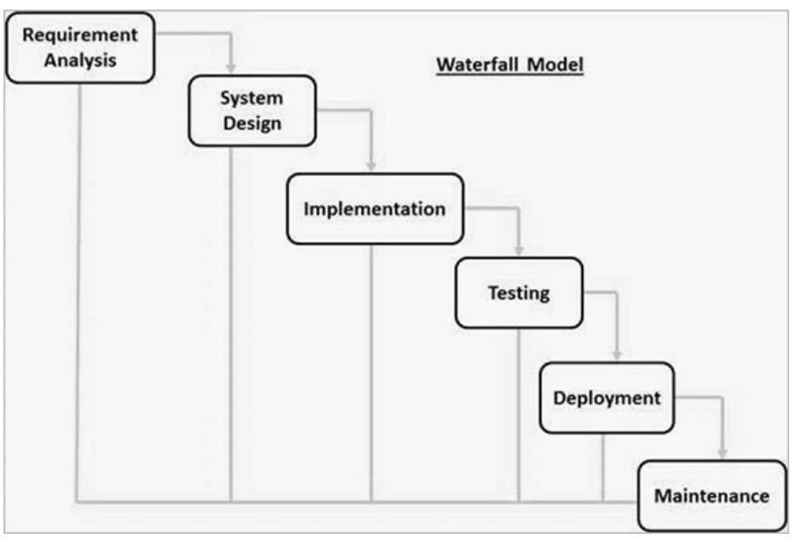
WATERFALL MODEL
Winston Royce introduced the Waterfall Model in 1970.This model has five phases: Requirements analysis and specification, design, implementation, and all kind of testing like unit testing, integration and system testing, and deployment and maintenance.

Slide 24
When to use SDLC Waterfall Model?
Some Circumstances where the use of the Waterfall model is most suited are:
When the requirements are constant and not changed regularly.
A project is short
Where the tools and technology used is consistent and is not changing
When resources are well prepared and are available to use.

Slide 25
Advantages of Waterfall model
This model is simple to implement also the number of resources that are required for it is minimal.
The requirements are simple and explicitly declared; they remain unchanged during the entire project development.
The start and end points for each phase is fixed, which makes it easy to cover progress.
The release date for the complete product, as well as its final cost, can be determined before development.
It gives easy to control and clarity for the customer due to a strict reporting system.

Slide 26
Disadvantages of Waterfall model
In this model, the risk factor is higher, so this model is not suitable for more significant and complex projects.
This model cannot accept the changes in requirements during development.
It becomes tough to go back to the phase. For example, if the application has now shifted to the coding phase, and there is a change in requirement, It becomes tough to go back and change it.
Since the testing done at a later stage, it does not allow identifying the challenges and risks in the earlier phase, so the risk reduction strategy is difficult to prepare.
No Feedback- No experiment-no change -Parallelism-no -1st one team then next- ideal resource
No flexibility-rigidity High risk- House example- bedroom , kitchen all problem come to know

Slide 27
Incremental Model
Incremental Model is a process of software development where requirements divided into multiple standalone modules of the software development cycle.
In this model, each module goes through the requirements, design, implementation and testing phases.
Every subsequent release of the module adds function to the previous release. The process continues until the complete system achieved.
1st module- then add something in 1st module which is 2nd module-
Development is not done in once -module by module development
Lock requirement phase-make SRS document then starts module1 development
Maximum customer interaction so chances of error is less- 1st module developed and delivered to customer for use-then customer can add changes for next module
Full cost, full manpower, full machinery not involve at once
Early release product demand
When updation come new features included

Slide 28
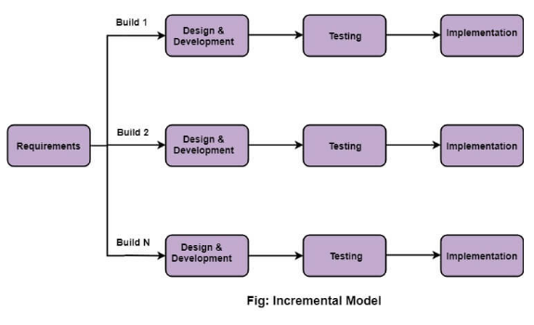

When we use the Incremental Model?
When the requirements are huge
A project has a lengthy development schedule.
When Software team are not very well skilled or trained.
When the customer demands a quick release of the product.
You can develop prioritized requirements first.

Slide 29
Advantage of Incremental Model
Errors are easy to be recognized.
Easier to test and debug
More flexible.
Simple to manage risk because it handled during its iteration.
The Client gets important functionality early.
Disadvantage of Incremental Model
Need for good planning
Total Cost is high.

Slide 30
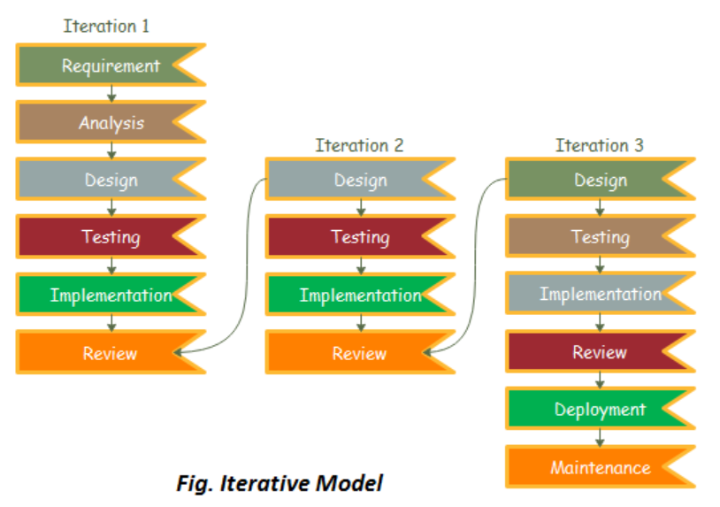
ITERATIVE MODEL
In this Model, you can start with some of the software specifications and develop the first version of the software.
After the first version if there is a need to change the software, then a new version of the software is created with a new iteration.

Slide 31
The various phases of Iterative model are as follows:
1. Requirement gathering & analysis: In this phase, requirements are gathered from customers and check by an analyst whether requirements will fulfil or not. Analyst checks that need will achieve within budget or not. After all of this, the software team skips to the next phase.
2. Design: In the design phase, team design the software by the different diagrams like Data Flow diagram, activity diagram, class diagram, state transition diagram, etc.
3. Implementation: In the implementation, requirements are written in the coding language and transformed into computer programmes which are called Software.
4. Testing: After completing the coding phase, software testing starts using different test methods. There are many test methods, but the most common are white box, black box, and grey box test methods.
5. Deployment: After completing all the phases, software is deployed to its work environment.
6. Review: In this phase, after the product deployment, review phase is performed to check the behavior and validity of the developed product. And if there are any error found then the process starts again from the requirement gathering.
7. Maintenance: In the maintenance phase, after deployment of the software in the working environment there may be some bugs, some errors or new updates are required. Maintenance involves debugging and new addition options.

Slide 32
When to use the Iterative Model?
When requirements are defined clearly and easy to understand.
When the software application is large.
When there is a requirement of changes in future.
Advantage(Pros) of Iterative Model:
Testing and debugging during smaller iteration is easy.
A Parallel development can plan.(parallel project can be developed)
It is easily acceptable to ever-changing needs of the project.(different versions can be implemented)
Risks are identified and resolved during iteration.
Limited time spent on documentation and extra time on designing.
Disadvantage(Cons) of Iterative Model:
It is not suitable for smaller projects.
More Resources may be required.
Design can be changed again and again because of imperfect requirements.
Requirement changes can cause over budget.
Project completion date not confirmed because of changing requirements.( no of iteration not confirmed so completion date not confirmed)

Slide 33
Evolutionary model
Evolutionary is a combination of Iterative and Incremental model of software development life cycle.
Evolutionary model suggests breaking down of work into smaller chunks, prioritizing them and then delivering those chunks to the customer one by one.
The number of chunks is huge and is the number of deliveries made to the customer. The main advantage is that the customer’s confidence increases as he constantly services from the beginning of the project to verify and validate his requirements. The model allows for changing requirements as well as all work in broken down into maintainable work chunks.

Slide 34
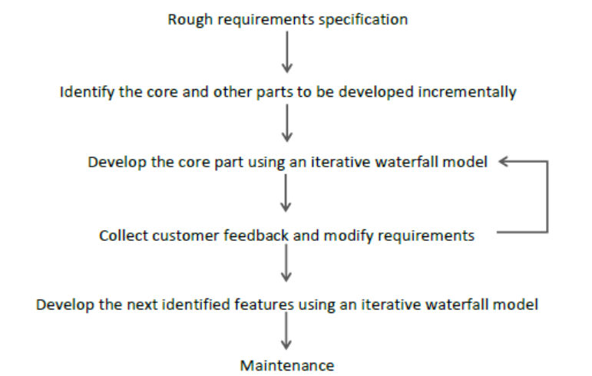
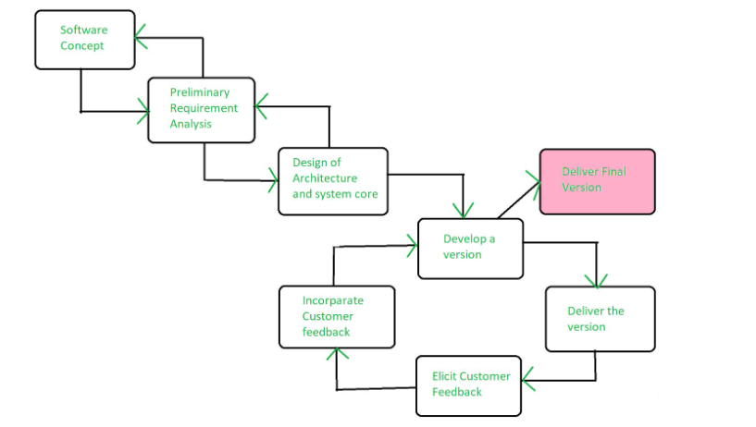

Slide 35
Advantages:
In evolutionary model, a user gets a chance to experiment partially developed system.
It reduces the error because the core modules get tested thoroughly.
Disadvantages:
Sometimes it is hard to divide the problem into several versions that would be acceptable to the customer which can be incrementally implemented and delivered.

Slide 36
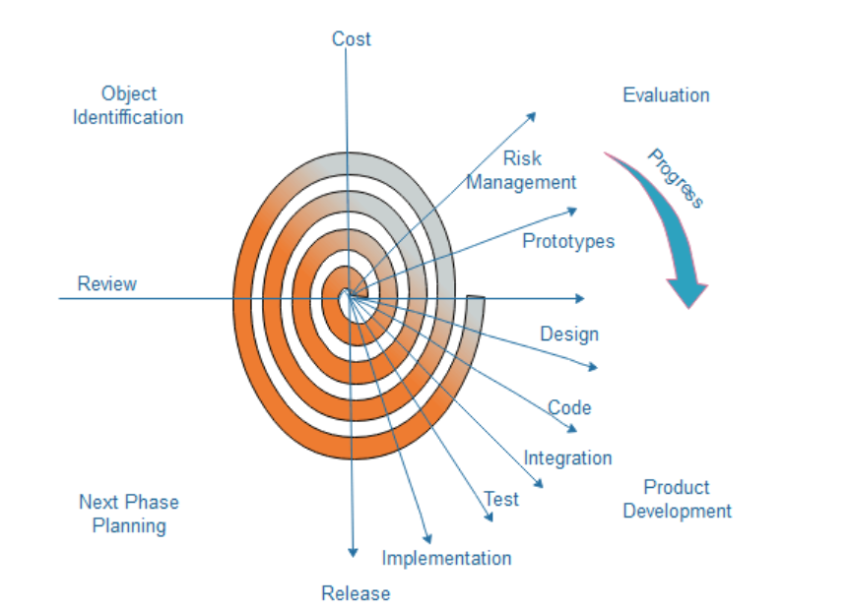
Spiral Model-
1st loop cover 4 phases
Then if needed modification then 2nd loop continues till PM satisfy that a perfect product.
Used for large project like ISRO,NASA
1. Risk Handling-Where analysis of risk is very important this model is used i.e. more focus on risk
2. Radius- more means cost more
3.Angular dimension- shows progress
4. Meta model

Slide 37
Spiral Model
The spiral model, initially proposed by Boehm.
The spiral model has four phases. A software project repeatedly passes through these phases in iterations called Spirals. Using the spiral model, the software is developed in a series of incremental releases.
Objective setting: Each cycle in the spiral starts with the identification of purpose for that cycle, the various alternatives that are possible for achieving the targets, and the constraints that exists.
Risk Assessment and reduction: The next phase in the cycle is to calculate these various alternatives based on the goals and constraints. The focus of evaluation in this stage is located on the risk perception for the project.
Development and validation: The next phase is to develop strategies that resolve uncertainties and risks. This process may include activities such as benchmarking, simulation, and prototyping.
Planning: Finally, the next step is planned. The project is reviewed, and a choice made whether to continue with a further period of the spiral. If it is determined to keep, plans are drawn up for the next step of the project.

Slide 38
When to use Spiral Model?
When the project is large
When requirements are unclear and complex
When changes may require at any time
Large and high budget projects
Advantages
High amount of risk analysis
Useful for large and mission-critical projects.
Disadvantages
Can be a costly model to use.
Doesn't work well for smaller projects.
Time

Slide 39
PROTOTYPE MODE
A prototype is a toy implementation of the system.
In many instances, the client only has a general view of what is expected from the software product.
In such a scenario where there is an absence of detailed information regarding the input to the system, the processing needs, and the output requirement, the prototyping model may be employed.

Slide 40
Steps of Prototype Model
Requirement Gathering and Analyst
Quick Decision
Build a Prototype
Assessment or User Evaluation
Prototype Refinement
Engineer Product
Advantage of Prototype Model
Reduce the risk of incorrect user requirement
Good where requirement are changing/uncommitted
Support early product marketing
Errors can be detected much earlier as the system is made side by side.

Slide 41
Disadvantage of Prototype Model
An unstable/badly implemented prototype often becomes the final product.
Difficult to know how long the project will last.
Easy to fall back into the code and fix without proper requirement analysis, design, customer evaluation, and feedback.
Prototyping tools are expensive.
Special tools & techniques are required to build a prototype.
It is a time-consuming process.

Slide 42
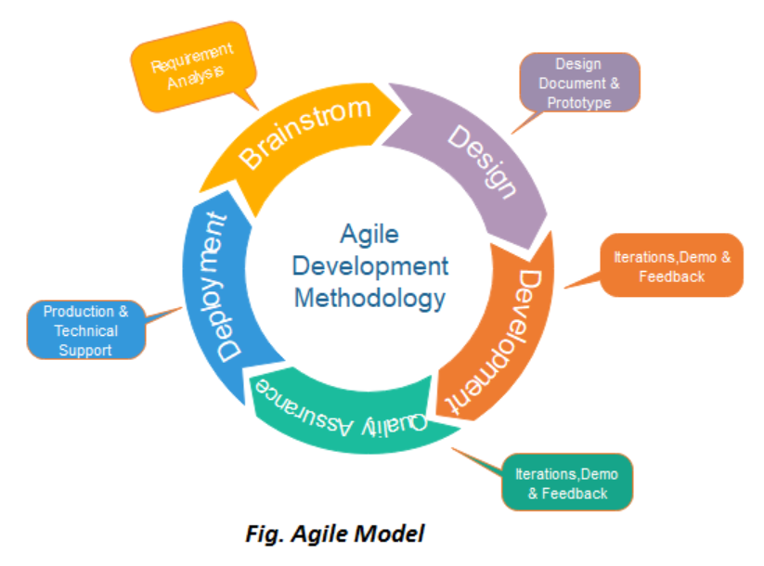
Agile Model
Means move quickly –if completely develop takes more time to finish
Project divided into small projects but work parallelly
All work in same label to share knowledge freely(startups)
Parallel development
Not work more in requirement gathering, documentation, design
More focus on development and release fast
Every week customer meeting
Version are coming very fast how( laptop example)
Large project –breaks into chunks-called-iteration
Develop-test-release-feedback(major)eg.online purchase we check feedback
Iteration developed in parallel.
Large project-chunks-Release-feedback-enhance-re-release

Slide 43
Agile methods break tasks into smaller iterations, or parts do not directly involve long term planning. The project scope and requirements are laid down at the beginning of the development process.
Plans regarding the number of iterations, the duration and the scope of each iteration are clearly defined in advance.
The division of the entire project into smaller parts helps to minimize the project risk and to reduce the overall project delivery time requirements.
Each iteration involves a team working through a full software development life cycle including planning, requirements analysis, design, coding, and testing before a working product is demonstrated to the client.

Slide 44
1.Requirements gathering: In this phase, you must define the requirements. You should explain business opportunities and plan the time and effort needed to build the project. Based on this information, you can evaluate technical and economic feasibility.
2. Design the requirements: When you have identified the project, work with stakeholders to define requirements. You can use the user flow diagram or the high-level UML diagram to show the work of new features and show how it will apply to your existing system.
3. Construction/ iteration: When the team defines the requirements, the work begins. Designers and developers start working on their project, which aims to deploy a working product. The product will undergo various stages of improvement, so it includes simple, minimal functionality.

Slide 45
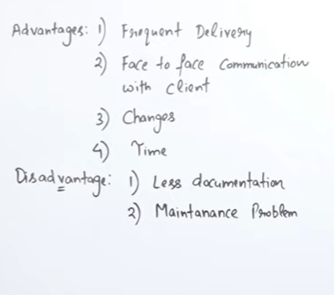
4.Testing: In this phase, the Quality Assurance team examines the product's performance and looks for the bug.
5. Deployment: In this phase, the team issues a product for the user's work environment.
6. Feedback: After releasing the product, the last step is feedback. In this, the team receives feedback about the product and works through the feedback.

Slide 46
Waterfall model | Iterative model | Prototype model | Incremental model | Evolutionary model | Spiral model | Agile model
Basic, Rigid, Inflexible, (Start and end user interaction) | Problem well understood After each stage feedback can be given | User requirement not cleared. No early lock on requirement. High user involvement Reusability | Module by module delivery But requirements locked Easy to test and debug | Large Project Same as incremental Difference is here requirement not locked | Risk handling is more, Not for small project No early lock on requirement | Flexible Advanced Parallel. Project divided into small projects All work in same label, to share ideas freely

